Slide 1
Credit Risk Predictive Modelling
4EK416 – Maksim Obukhov, Nam Hoang

Slide 2
Contents
Introduction of problem
Data preprocessing
Modeling
Evaluation
Scorecard

Slide 3
Problem introduction
Dataset:
622 489 observations
24 attributes
1 binary target
Supervised learning
modelling techniques
→ scorecard
→ determine whether to provide a client with a loan

Slide 4
Data preprocessing

Slide 5
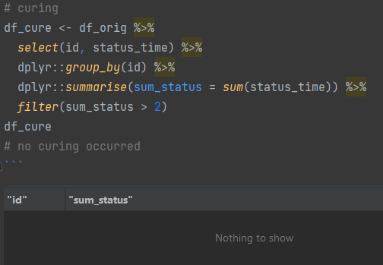
Data preprocessing - Curing check
Curring: If client defaults but later on pays off his debt
Simple check through attribute: “Statust_time”
No curring happend

Slide 6
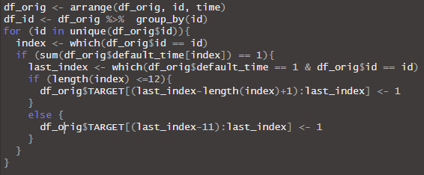
Data preprocessing – Target
Binary variable
1 or True: client will default in upcoming 12 months
0 or False: client will not default in upcoming 12 months
Through default_time attribute

Slide 7
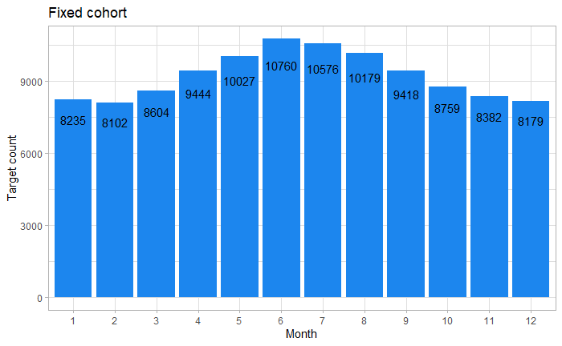
Data preprocessing – Subsetting cohort
Fixed cohort
Provides more consistent and controlled analysis
Easier comparison and interpretation
6th month, June

Slide 8
Data preprocessing – Feature engineering
diff_bank_time
Time client spend at different bank
balance_paid
Ammount of debt paid back to bank
time_since_orig
Time passed by since origination
time_until_mat
Time until the loan should be officailly paid off
loan_length
Length of loan

Slide 9
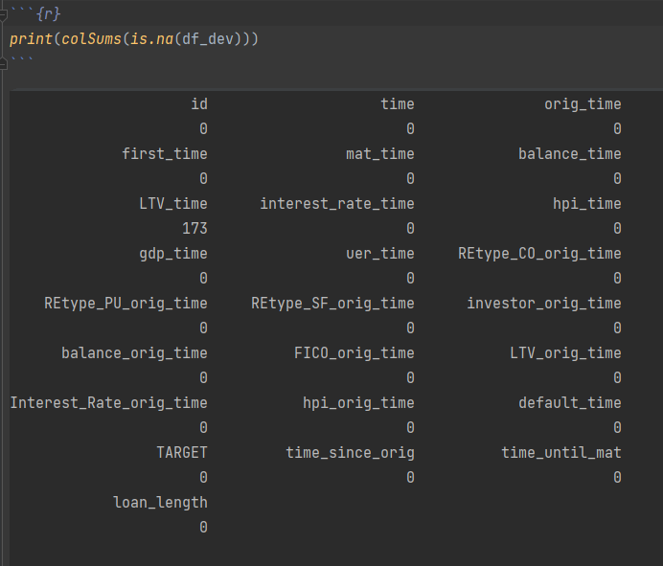
Data preprocessing – NAs treatment
Only missing values in attribute LTV_time
Missing for all observations of specific clients
→ could not use imputing techniques for time series
Proportion of rows with missing values < 1%
Deletion should not bias our results

Slide 10
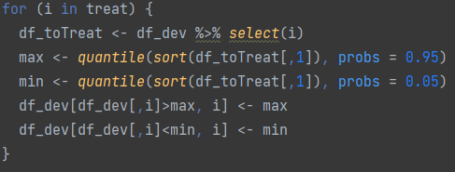
Data preprocessing – Outlier treatment
For selected continious attribures
Outliers defined as any value over 95th OR below 5th percentile
Values were substituted with 95th OR 5th percentile respectively

Slide 11
Modeling

Slide 12
Modeling – train, test split
Seed: 150520
Split: 70 : 30 ratio

Slide 13
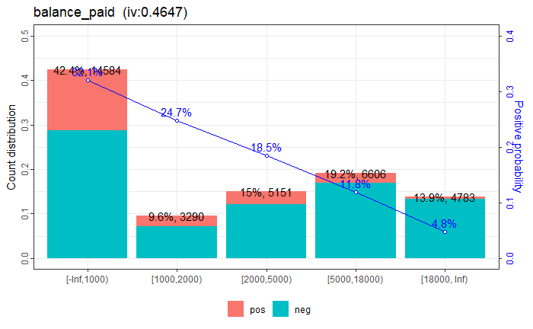
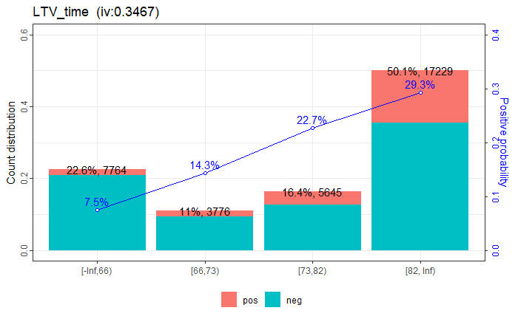
Modeling - attribute binnarization examples
Good first binning: (high IV, linear relationship)

Slide 14
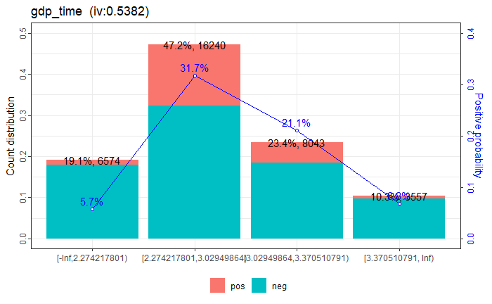
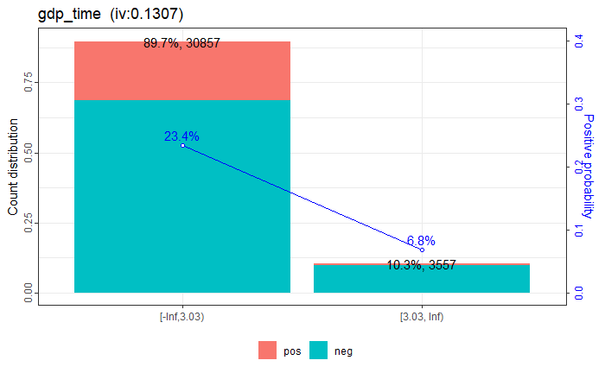
Modeling - attribute binnarization examples
Bad first binning: (high IV, non-linear relationship)​ → transformed into good one
Note: Notice the IV drop

Slide 15
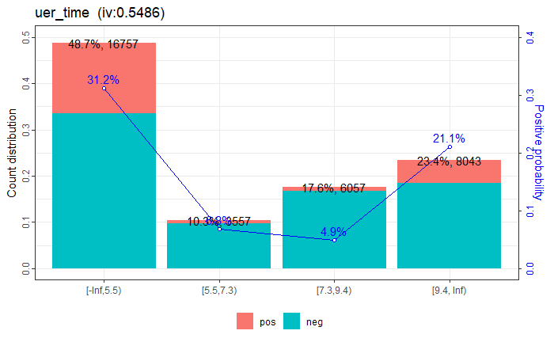
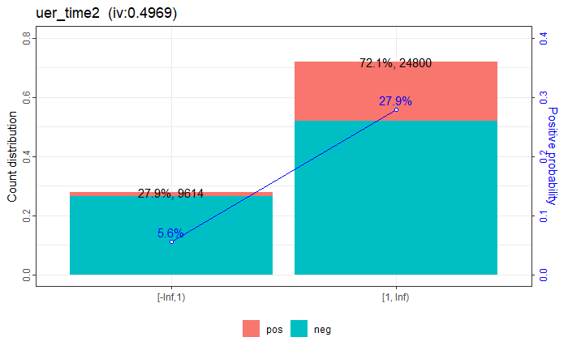
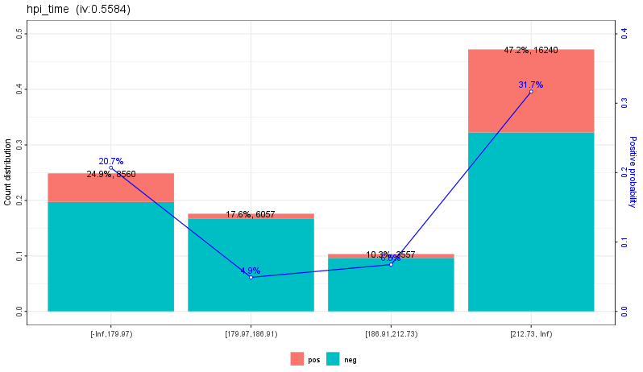
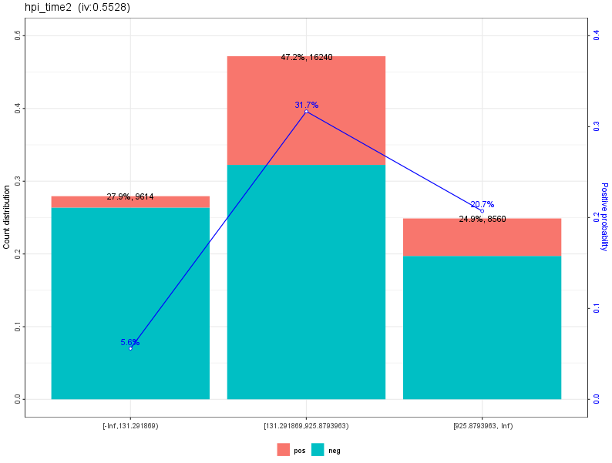
Modeling - attribute binnarization examples
Special cases: quadratic relationship
Note: happend to uer_time and hpi_time

Slide 16
Modeling - attribute binnarization summary
Manually binned 9 attributes
Created 2 new attributes
Quadratic relationship
22 binned attributes
Linear: 18
IV > 0.10: 14

Slide 17
Modeling – correlation matrix
Attribute pairs | correlation | P_value (%) | significance
hpi_time | uer_time | -0.92 | 0.000 | ***
REtype_PU_orig_time | REtype_SF_orig_time | -0.48 | 0.012 | ***
balance_time | balance_orig_time | 0.99 | 0.000 | ***
interest_rate_time | FICO_orig_time | -0.45 | 0.001 | ***
LTV_time | LTV_orig_time | 0.45 | 3.644 | *
interest_rate_time | Interest_Rate_orig_time | 0.5 | 0.002 | ***
LTV_time | hpi_orig_time | 0.62 | 0.007 | ***
hpi_time | mns_since_orig | -0.59 | 0.000 | ***
uer_time | mns_since_orig | 0.63 | 0.000 | ***
hpi_time | mns_until_mat | 0.52 | 0.001 | ***
uer_time | mns_until_mat | -0.53 | 0.001 | ***
mns_since_orig | mns_until_mat | -0.83 | 0.000 | ***
mns_since_orig | balance_paid | 0.5 | 0.000 | ***
mns_until_mat | balance_paid | -0.57 | 0.000 | ***
hpi_time2 | uer_time2 | 1 | 0.000 | ***

Slide 18
Modeling – Feature importance
Selected by IV and correlation coeficient
Shortlist:
Feature | Information Value
Uer_time2 | 0.49
Balance_paid | 0.46
LTV_time | 0.35
Interest_rate_time | 0.29
Loan_length | 0.10
Balance_time | 0.08

Slide 19
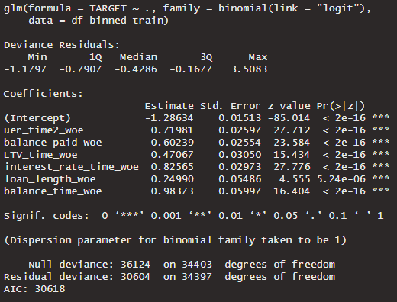
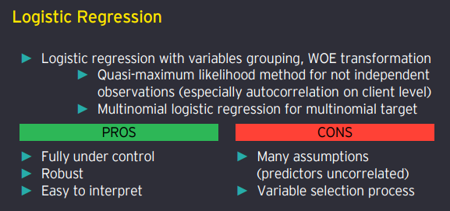
Modeling – logistic regression

Slide 20
Evaluation

Slide 21
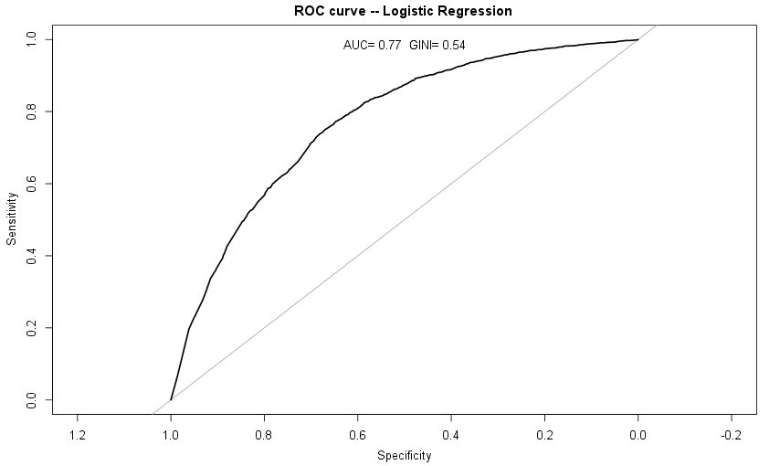
ROC Curve

Slide 22
Final Scorecard ​
Predictor | Group | Points | WoE | Default Rate | Percentage of population
uer_time2 | [-Inf,1) | 40 | -1.5419 | 5.6% | 27.9%
 | [1, Inf) | -9 | 0.335735 | 27.9% | 72.1%
balance_paid | [-Inf,1000) | -11 | 0.534704 | 32.1% | 42.4%
 | [1000,2000) | -4 | 0.173164 | 24.7% | 95.6%
 | [2000,5000) | 4 | -0.195858 | 18.5% | 15.0%
 | [5000,18000) | 15 | -0.720835 | 11.9% | 19.2%
 | [18000, Inf) | 37 | -1.71365 | 4.7% | 13.9%
LTV_time | [-Inf,66) | 21 | -1.22726 | 7.5% | 22.6%
 | [66,73) | 9 | -0.500606 | 14.4% | 11.0%
 | [73,82) | -1 | 0.0598554 | 22.7% | 16.4%
 | [82, Inf) | -7 | 0.404998 | 29.3% | 50.1%
interest_rate_time | [-Inf,6.4) | 23 | -0.770427 | 11.3% | 4.0%
 | [6.4,6.8) | 1 | -0.0378742 | 21.0% | 10.2%
 | [6.8, Inf) | -13 | 0.43398 | 29.9% | 50.3%
loan_length | [-Inf,117) | 8 | -1.05437 | 8.8% | 11.1%
 | [117,121) | -1 | 0.0689173 | 22.9% | 61.5%
 | [121, Inf) | -1 | 0.144206 | 24.2% | 27.4%
balance_time | [-Inf,50000) | 35 | -0.981627 | 9.4% | 58.8%
 | [50000,120000) | 10 | -0.285992 | 17.2% | 2.5%
 | [120000,190000) | -2 | 0.064163 | 22.8% | 20.3%
 | [190000, Inf) | -7 | 0.188993 | 25.0% | 48.4%
Parameters
Target points: 255
Target odds: 1/500
Points to double the odds: 25

Slide 23
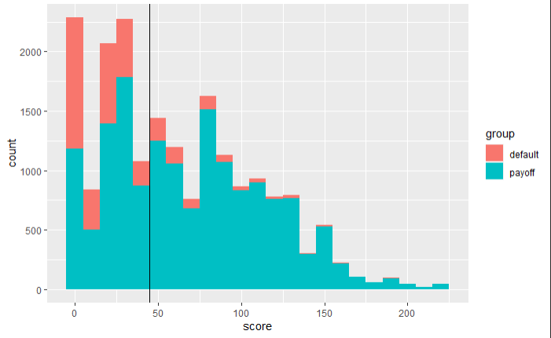
Scorecard – applied to testing dataset
Conclusion:
Breakpoint: 45 points
0-45: risky client
46+: normal client

Slide 24
Scorecard – applied to testing dataset
Normal client: 11 089
93.16 % to pay off his debt
6.84 % to deafult
Risky client 8 400
66.92 % to pay off his debt
33.08 % to deafult
1/3 of "bad clients" will be caught off but 2/3 will not get loan
Further modeling for this group of clients would be ideal to not lose aprox 5.6 thousand clients

Slide 25
Thank you for you attention

